Slide 1
Kafka Definitive Guide
Summary By NgocTD

Slide 2




Publish/Subscribe Messaging
Subscriber
Publisher
Subscriber
Publisher
Subscriber
Notes:
- concept of pub/sub and why it is a critical component of data-driven application
- Pub/sub messaging is a pattern that is characterized by the sender (publisher) of a piece of data (message) not specifically directing it to a receiver. Instead, the publisher classifies the message somehow, and that receiver (subscriber) subscribes to receive certain classes of message.

Slide 3






Messages and Batches
Collection of messages
Being produced
to the same topic and partition.
The unit of data.
An array of bytes.
Latency and throughput.
Written to the same partition
By modulo the total number
of partitions in the topic.
Batches compressed.
Notes:
The unit of data within Kafka is called a message. You can think of this as similar to a row or a record.
A message if simply an array of bytes.
A message can have an optional piece of metadata, which is referred to as a key.
Messages are written into Kafka in batches.
Trade-off between latency and throughput: more messages can be handled per unit of time.
Batches are also typically compressed.

Slide 4


Topics and Partitions
Categorized into topics.
Broken down
into a number of partitions.
Notes:
Messages in Kafka are categorized into topics. The closest anologies for a topic are a database table.
Partitions are also the way that Kafka provides redundancy and scalability. Each partition can be hosted on a different server, which means that a single topic can scaled horizontally across multiple servers to provide performance far beyond the ability of a single server.

Slide 5

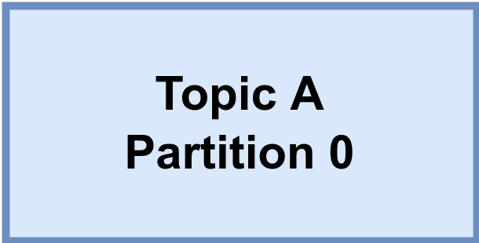

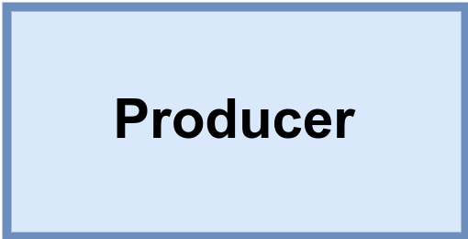
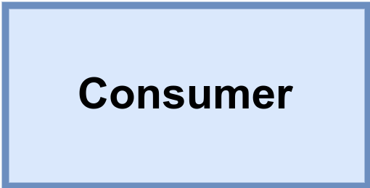

Brokers and Clusters
Kafka cluster
Messages
for A/0
Messages
from A/0
Leader
Replicate
A/0
Replicate
A/1
Messages
for A/1
Messages
from A/1
Leader

Slide 6
Multiple Clusters

Slide 7
Use cases
Activity tracking.
Commit log.
Messaging.
Streaming processing.
Metrics and logging.

Slide 8
Kafka Producers: Writing Messages to Kafka
Topic A
Partition 0
Batch 0
Batch 1
ProducerRecord
Batch 2
Topic
Kafka broker
Send()
[Partition]
Serializer
Partitioner
[Key]
Topic B
Partition 1
Value
Batch 0
When successful,
return metadata
include topic, partition
and the offset
If can’t retry,
throw
exception
Batch 1
Batch 2
Retry?
Fail?
Notes:
Once we send the ProducerRecord, the first thing the producer will do is serialize the key and value objects to byte arrays so they can be sent over the network.

Slide 9
Kafka Consumers: Reading Data from Kafka
Topic T1
Consumer group 1
Partition 0
Consumer 1
Partition 1
Consumer 2
Partition 2
Consumer 3
Partition 3
Consumer 4
Consumer 5

Slide 10
Kafka Consumers: Reading Data from Kafka
Topic T1
Consumer group 1
Partition 0
Consumer 1
Partition 1
Consumer 2
Partition 2
Consumer 3
Partition 3
Consumer 4
Consumer group 2
Consumer 1
Consumer 2

Slide 11
Consumer Groups and Partition Rebalance
Notes:
Moving partition ownership from one consumer to another is called a rebalance. Rebalances are important because they provide the consumer group with high availability and scalability

Slide 12
Process of Assigning Partitions to Consumers Work
Notes:
Moving partition ownership from one consumer to another is called a rebalance. Rebalances are important because they provide the consumer group with high availability and scalability

Slide 13
Static Group Membership
Notes:
Moving partition ownership from one consumer to another is called a rebalance. Rebalances are important because they provide the consumer group with high availability and scalability

